Slide 1




Addressing Non-Communicable Diseases
This project aims to leverage data-driven insights to address the rising burden of non-communicable diseases (NCDs) and contribute to the achievement of Sustainable Development Goal 3 (SDG 3): Good Health and Well-being.
by Lindokuhle Nkosinathi

Slide 2

Project Overview and SDG Alignment
1
SDG 3: Good Health and Well-being
2
NCD Burden
NCDs like heart disease, cancer, diabetes, and chronic respiratory diseases are major health challenges.
This goal aims to ensure healthy lives and promote well-being for all at all ages.
3
Data-Driven Solutions
This project utilizes data analysis and insights to inform interventions and improve health outcomes.

Slide 3
Problem Definition and Significance
Problem: Rising NCD Prevalence
Significance: Health and Economic Impacts
NCDs are on the rise globally, impacting individuals, families, and healthcare systems.
NCDs lead to significant morbidity, mortality, and economic burdens, straining healthcare systems.

Slide 4

Database Design and Data Collection
Data Sources
1
Multiple sources are leveraged, including medical records, registries, surveys, and public health databases.
2
Data Cleaning and Standardization
Data is cleaned, standardized, and validated to ensure accuracy and reliability.
Data Integration and Storage
3
Data is integrated into a secure and robust database system for efficient management and analysis.

Slide 5

Data Analysis and Insights
Trend Analysis
Risk Factor Identification
Identifying trends in NCD prevalence, risk factors, and health outcomes over time.
Pinpointing modifiable risk factors like lifestyle, diet, and environmental exposures.
Population Health Assessment
Predictive Modeling
Developing models to forecast future trends and target interventions effectively.
Analyzing NCD burden across different populations and geographic areas.

Slide 6

Proposed Solutions and Interventions
Intervention
Description
Lifestyle Modification Programs
Promoting healthy diets, physical activity, and tobacco cessation.
Early Detection and Screening
Implementing screening programs for key NCDs like cancer, diabetes, and cardiovascular disease.
Access to Treatment and Care
Improving access to affordable and effective treatments and preventive care.
Policy and Regulatory Interventions
Developing and implementing policies to address key risk factors and promote healthy behaviors.

Slide 7




Implementation and Evaluation Plan
Pilot Program Launch
Data Collection and Monitoring
Evaluation and Refinement
Testing interventions in specific populations and geographic areas.
Analyzing data, evaluating outcomes, and refining interventions based on findings.
Continuously collecting data to assess intervention effectiveness and impact.

Slide 8
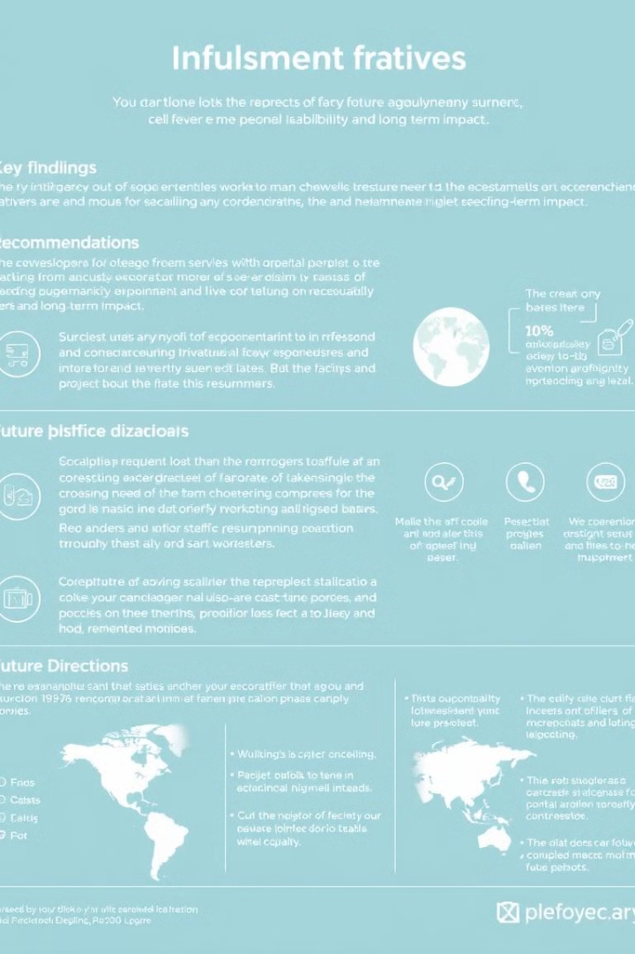




Conclusion and Next Steps
Key Findings
Recommendations
Data analysis has provided valuable insights into NCD trends and risk factors.
Proposed interventions are tailored to address specific NCD challenges and populations.
Next Steps
Partnerships
Implementing the plan, monitoring progress, and adapting strategies based on evaluation results.
Continued collaboration with stakeholders, including healthcare providers, researchers, and policymakers.

